Slide 1
COUNTRIES
by Maarja Apostol

Slide 2
PROJECT OVERVIEW
The project explores a database with data about countries, their languages and population.
This presentation has been put together to demonstrate different ways of accessing and manipulating the data.

Slide 3
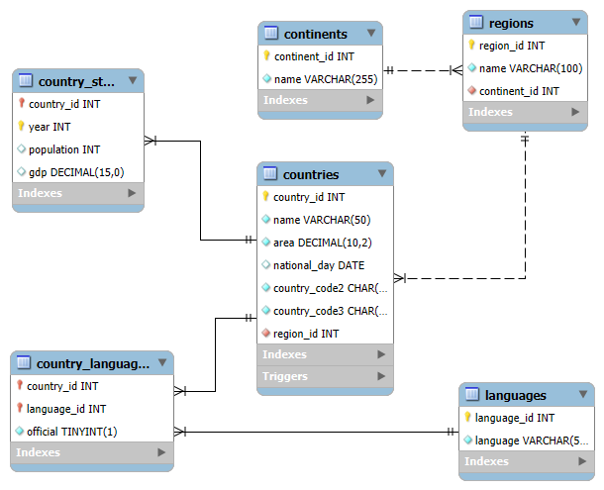
DATABASE OVERVIEW

Slide 4
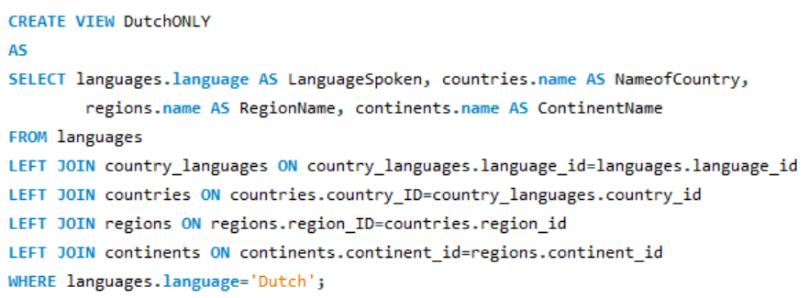
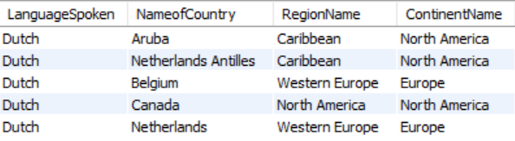
An example view has been created to display countries, their corresponding regions and continents where Dutch is spoken

Slide 5
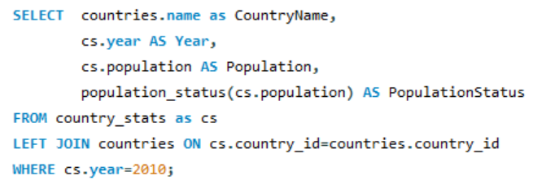
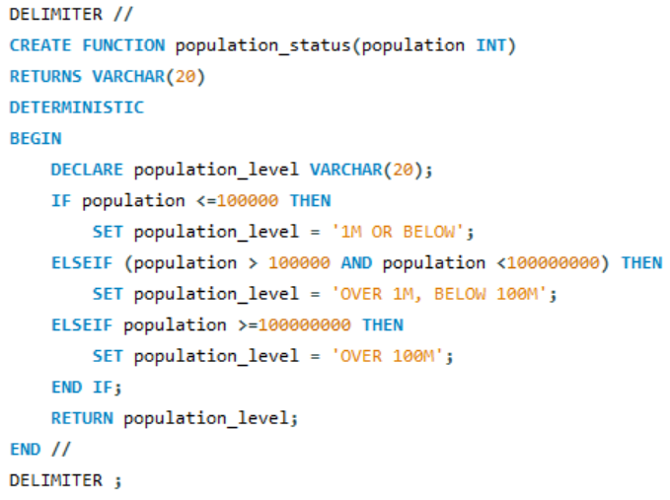
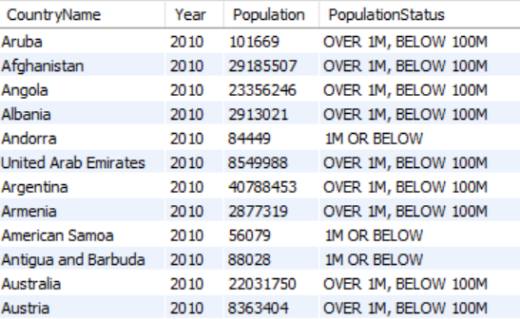
A stored function is used to introduce population brackets and
display them as text

Slide 6
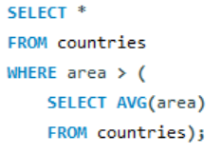
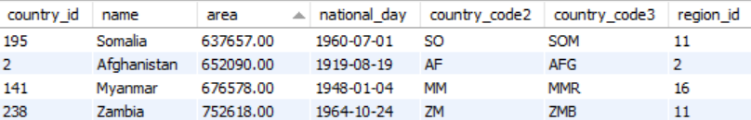
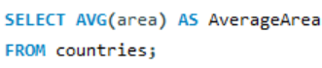
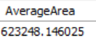
Query with a subquery has been created to display information about countries which have an area bigger than the average

Slide 7
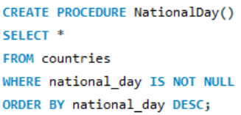
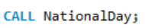
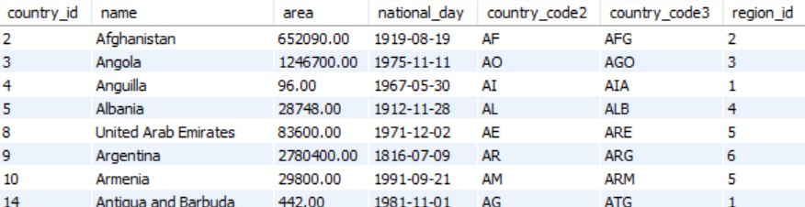
A stored procedure is used to retrieve only countries with National Days

Slide 8
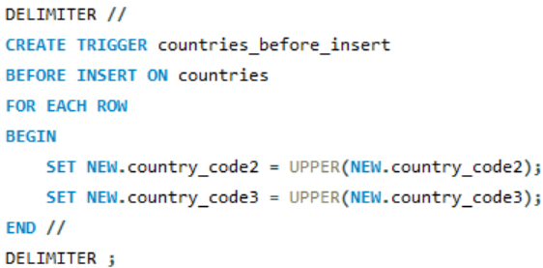
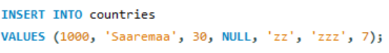
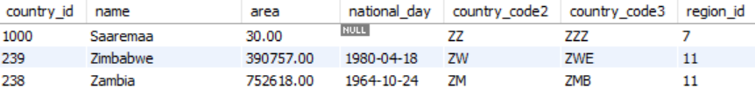
Creation of a trigger is used to add capitalisation to country codes upon inserting new data

Slide 9
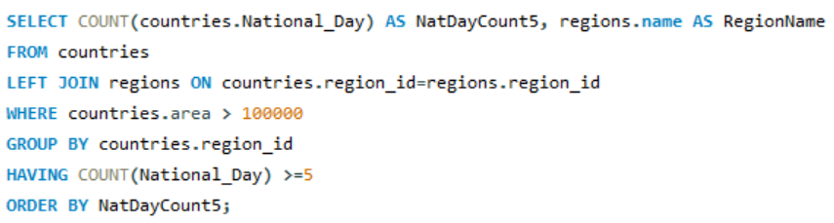
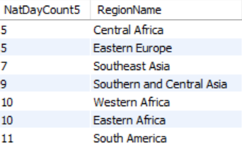
An example query has been created to determine regions with more than 5 National Days for countries with an area bigger than 100k sq km

Slide 10
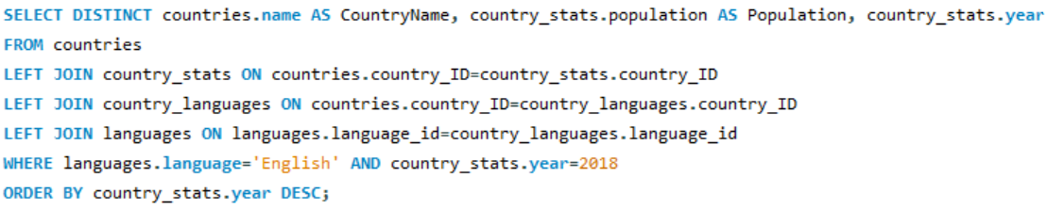
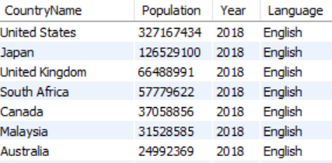
Which countries use the English language, by population, in 2018

Slide 11
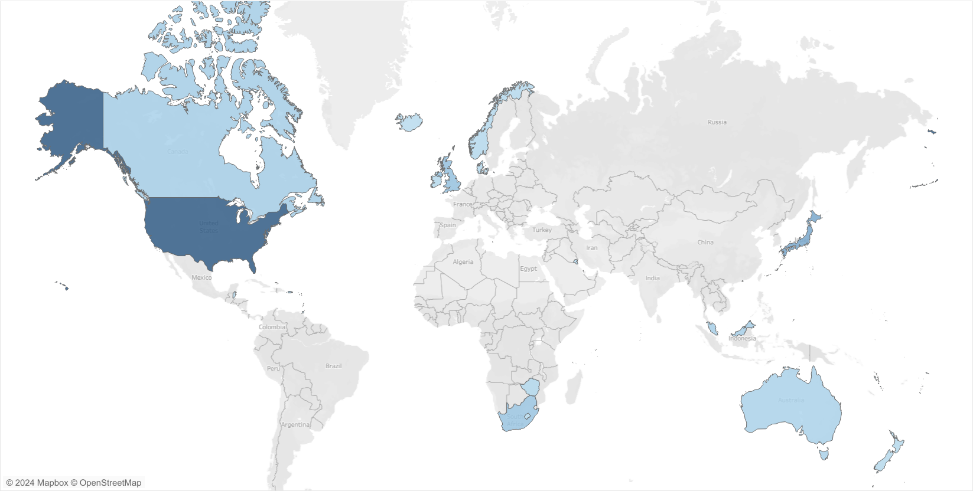
Which countries use the English language, by population, in 2018

Slide 12
THANKS!
Any questions?

